Slide 1


DEPARTMENT OF COMPUTER SCIENCE & ENGINEERING
SCHOOL OF COMPUTING
10214CS601 MINOR PROJECT -1
SUMMER SEMESTER(2024-2025)
REVIEW-II
“SMART NAVIGATION SYSTEM FOR BLIND PEOPLE”
SUPERVISED BY
Mrs. Minu Inba Shanthini Watson Benjamin ,M.E., ASSISTANT PROFESSOR
PRESENTED BY
Y.NITHIN (22UECS0753) (VTU22513)
SK. RAHILBASHA (22UECS0637) (VTU23896)
3. A.VIJAY KUMAR (22UECS0027) (VTU23513)

Slide 2
OVERVIEW
ABSTRACT
OBJECTIVE
INTRODUCTION
LITERATURE REVIEW (SOFT COPY OF PAPERS TO BE LINKED AS HYPERLINK)
DESIGN AND METHODOLOGIES
IMPLEMENTATION
TESTING
INPUT AND OUTPUT
INCLUDE DEMO VIDEO-1 (Till REVEW-1)
INCLUDE DEMO VIDEO-2(Complete Implementation of Project)
CONCLUSION
WEB REFERENCES LINK (TILL REVIEW DATE ALL LINKS TO BE INCLUDED DAY WISE)
PLAGIARISM REPORT OF PPT
REFERENCES

Slide 3
ABSTRACT
➤ One of the major problems faced by visually impaired people is navigating from one place to another. Commercially available walking canes only serve as obstacle detectors for these people.
➤ The need for an economical guidance and navigation system for the blind is long overdue. Existing solutions are highly cost-ineffective,rendering them available only to people on the higher end of the economic strata..
➤ A cheap and affordable piece of technology can help the blind commute to their workplace instead of relying on help from random strangers to even commute walkable distances
➤ This prototype is equipped with an ESP8266, a power source for the development board and coin motors along with a smartphone application, thereby making it accessible for even the working class visually impaired.

Slide 4
OBJECTIVES
Aim of the Project: A novel navigation system is designed and implemented which helps blind people to navigate safely. ATMEGA16 microcontroller was used to develop the smart obstacle detection system which allows the blind person to avoid obstacles using the feedback through vibration and voice.
ultrasonic sensors is to assist visually impaired individuals in safely and independently navigating their environment. Ultrasonic sensors work by emitting sound waves at a frequency higher than the audible range for humans. When these sound waves hit an object, they bounce back to the sensor, allowing it to measure the distance to that object.
Scope of the Project: In this project a walking stick has been designed to help the blind person to detect obstacles and navigate towards the destination. The proposed walking stick consists of a microcontroller, infrared sensors, a GPS receiver, label surface detection, a buzzer and a vibrating motor.
The scope of a project for a blind people navigation system using ultrasonic sensors includes developing the hardware and software necessary for real-time obstacle detection and navigation, creating an intuitive user interface that provides audio or haptic feedback, implementing algorithms for pathfinding and decision-making, conducting user testing to gather feedback and improve the system, and exploring integration with other technologies like GPS or smartphone apps to enhance functionality. Additionally, it involves engaging with the visually impaired community to ensure the system meets their needs and considering future enhancements to improve navigation capabilities.

Slide 5
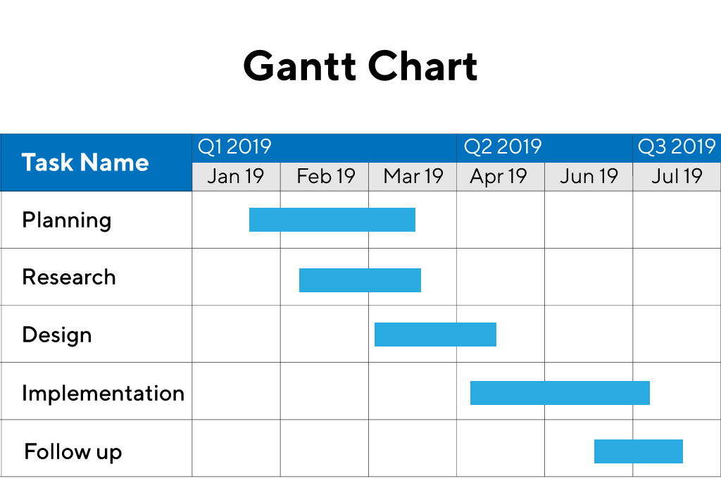
TIMELINE OF THE PROJECT
Sample Gantt Chart
Include as GANTT CHART
Include timeline from October 2023 to January 2024.

Slide 6
INTRODUCTION
Healthcare system is facing the digital transformations with the use of healthcare information system, electronic medical record, wearable and smart devices and handheld.
A navigation system for the personals with low visual impairments means; a system capable of providing accurate navigation facilities and capable of avoiding obstacle in the route towards their destination.
The development of navigation devices to make it possible to guide the blind through indoor and or outdoor surroundings to move and travel in unfamiliar surroundings is a challenging issue.
It is a challenging issue because of the major deficiencies such as, lack of preview, less knowledge of the surrounding, and limited access of the information for positioning.
Researchers are trying to develop a system that can make blind people more independent and to become aware of their surroundings.
The use of technological navigation system is one of the significant cases to deal with the miniaturization of electronics and the enhancement in processing power and sensing capabilities. According to the World Health Organization (WHO) about 285 million people are visually impaired out of which 39 million people are blin

Slide 7
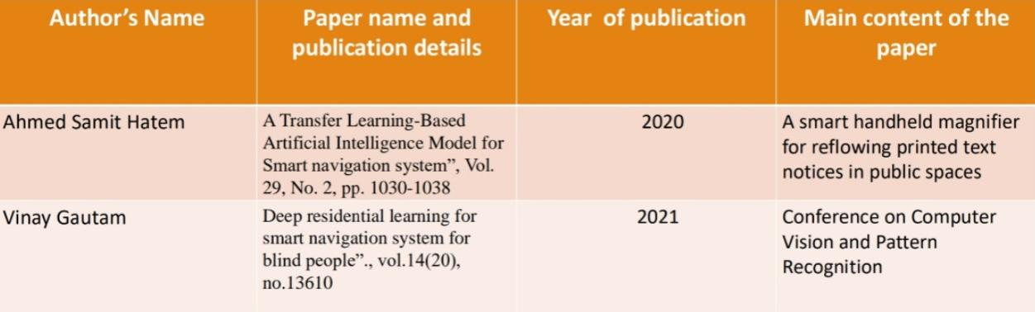
LITERATURE REVIEW

Slide 8
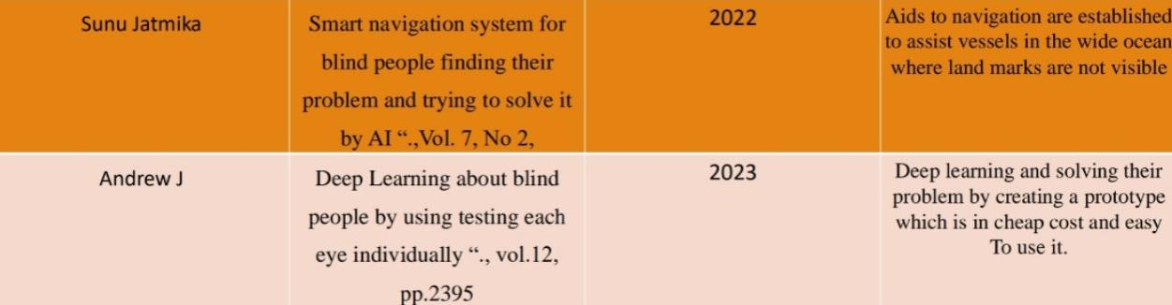

Slide 9
DESIGN AND METHODOLOGIES
MODULE 1:COLLECTION DATA AND MANIPULATION
• This paper describes the development of a navigation aid in order to assist blind and visually impaired people to navigate easily, safely and to detect any obstacles.
• The system is based on a microcontroller with synthetic speech output. In addition, it consists of two vibrators, two ultrasonic sensors mounted on the user’s shoulders and another one integrated into the cane.
• This aid is able to give information to the blind about urban walking routes and to provide real-time information on the distance of over-hanging obstacles within six meters along the travel path ahead of the user.
• The suggested system consists then in sensing the surrounding environment via sonar sensors and sending vibro-tactile feedback to the user of the position of the closest obstacles in range. For the ultrasonic cane, it is used to detect any obstacle on the ground

Slide 10
Module 2-Algorithm used for Blind Navigation
In a smart navigation system for blind people using ultrasonic sensors in a blind stick, several algorithms are used to detect obstacles and guide the user. The Thresholding algorithm is employed to detect obstacles by comparing the distance measurements from ultrasonic sensors against a predefined threshold. Reactive navigation algorithms provide real-time feedback, such as turning or stopping, when obstacles are detected. The system uses A* or Dijkstra’s algorithms for path planning to find the safest route around obstacles. Kalman filters are applied for sensor fusion to improve distance accuracy, while PID controllers help adjust the user’s direction in real-time. Auditory feedback algorithms provide sound cues to the user, indicating the proximity of obstacles, ensuring safe navigation with the blind stick.

Slide 11
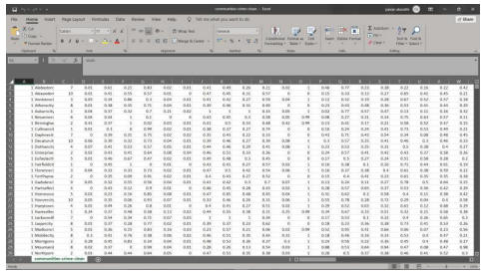
Step:1 Collection of data
Include screenshot and give brief description of the collection of data.
Eg,
It’s a sample only and may vary according to the project

Slide 12
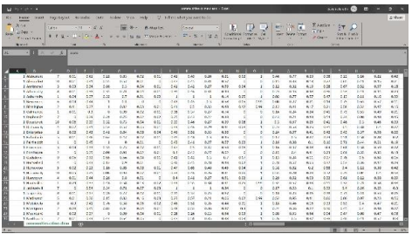
Step 2: Processing the data
Include screenshot and give brief description of the processing of data.
Eg,
It’s a sample only and may vary according to the project

Slide 13
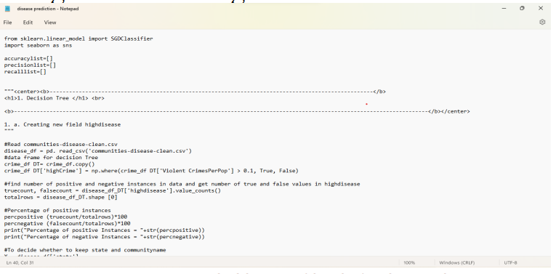
Step 3: Using algorithm’s name algorithm
Include screenshot of the algorithm
Eg,
It’s a sample only and may vary according to the project

Slide 14
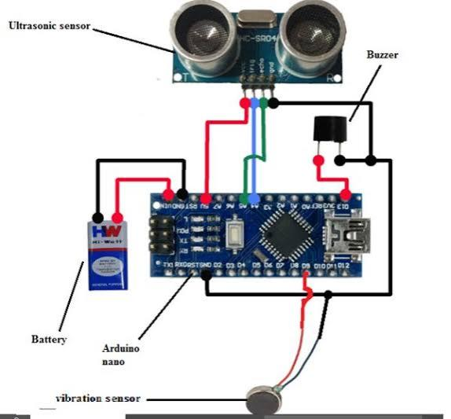
Step 4: The output

Slide 15
The Above Figure Represents the Smart navigation system for blind people, ultrasonic sensors play a critical role in detecting obstacles and environmental features that are otherwise inaccessible to visually impaired individuals. However, the challenge lies in output design how to convert sensor data into useful, accessible feedback that allows blind users to navigate their environment safely and independently. Since visual feedback is not an option, the output system must utilize non-visual cues, primarily audio feedback, haptic feedback (vibration), and potentially voice alerts.This section explains how the data from ultrasonic sensors can be processed and converted into actionable output for the user, including the various modes of feedback provided to assist with navigation.

Slide 16
IMPLEMENTATION
Architecture Diagram
Data –Flow Diagram
Use Case Diagram
Class Diagram
Activity Diagram
Sequence Diagram
Collaboration Diagram(If applicable)
E-R Diagram

Slide 17
Architecture Diagram
User Interface (Mobile App / Wearable Device):
Provides audio instructions, haptic feedback, and accepts voice commands.
Interfaces with the core navigation system for real-time updates
.
Voice Command Processor:
Recognizes and processes user voice commands (e.g., “recalculate route”).
Integrates with navigation logic to adjust routes based on user input.
Navigation Logic (Route Planning & Decision Engine):
Plans optimal routes based on the user’s starting point and destination.
Recalculates the route dynamically if obstacles are detected or if the user deviates from the planned path.
Sensor Module:
Includes sensors like ultrasonic, LiDAR, or cameras for obstacle detection.
Provides real-time environmental data to the navigation logic for obstacle avoidance.
GPS Module:
Tracks the user's current location using GPS.
Helps in accurate route planning and real-time updates.
Obstacle Detection & Avoidance System:
Processes data from sensors to detect nearby obstacles (e.g., objects, curbs, doorways).
Triggers feedback (audio or haptic) and adjusts route if necessary.

Slide 18
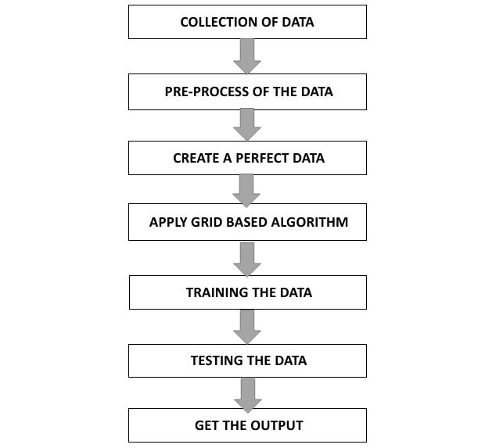
Data –Flow Diagram
Eg,
Give an explanation

Slide 19
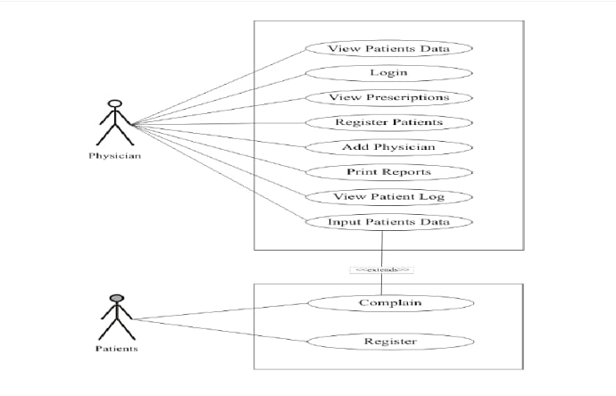
Use Case Diagram
Eg,

Slide 20
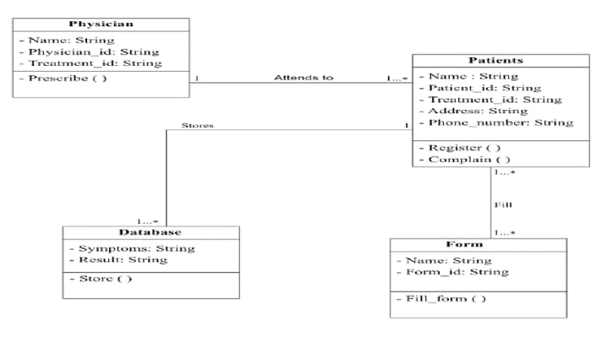
Class Diagram
Eg,

Slide 21
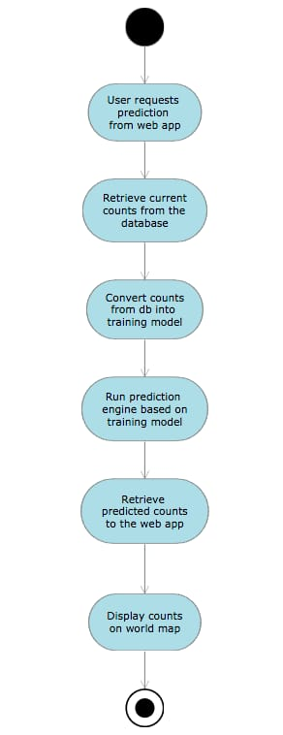
Activity Diagram
Eg,

Slide 22
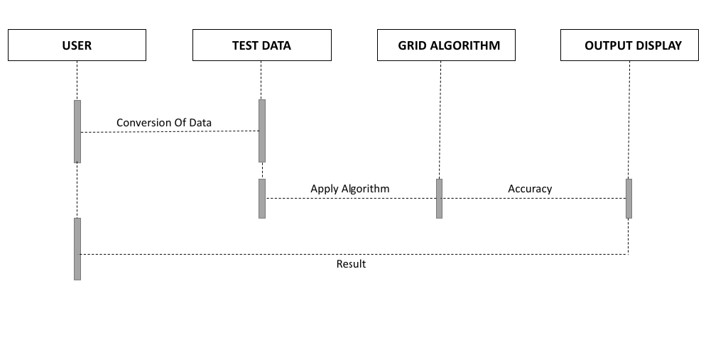
Sequence Diagram
Eg,

Slide 23
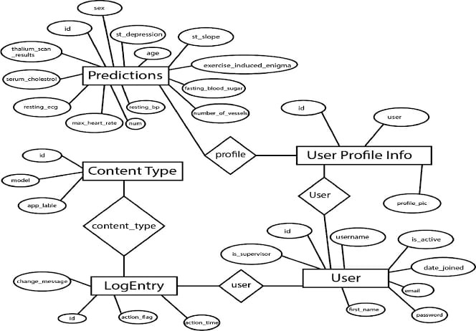
E-R Diagram
Eg,

Slide 24
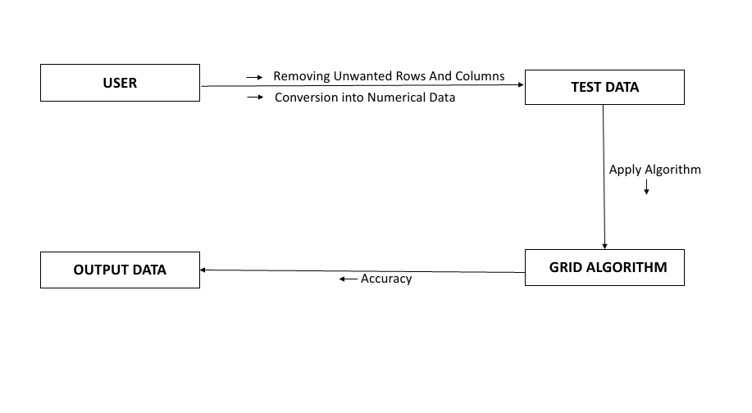
Collaboration Diagram(If applicable)
Eg,

Slide 25
TESTING
UNIT TESTING
INTEGRATION TESTING
FUNCTIONAL TESTING
WHITE BOX TESTING
BLACK BOX TESTING

Slide 26
UNIT TESTING
Unit testing for a Smart Navigation System for Blind People involves validating individual components to ensure they function correctly before integration. Key areas to test include object detection, route planning, haptic feedback, audio guidance, voice command processing, and sensor integration. Test cases should cover scenarios such as obstacle detection, accurate route generation, feedback responsiveness, and voice command accuracy. Automated tools like JUnit or PY Test can be used for core functions, while Selenium or Appium can test mobile interfaces. The goal is to ensure reliability, accessibility, and seamless interaction between the system's components, offering a safe and efficient navigation experience for users.
INTEGRATION TESTING
Integration testing for a Smart Navigation System for Blind People ensures that the system's various components work together seamlessly. This includes testing the interaction between object detection, route planning, feedback mechanisms (haptic and audio), voice commands, and sensors. For example, when an obstacle is detected, the system should accurately recalculate the route and provide both audio and vibration feedback to guide the user. Similarly, voice commands should trigger the appropriate navigation adjustments, and sensor data from multiple sources (e.g., ultrasonic and LiDAR) should be fused correctly to avoid obstacles. Additionally, the integration between the mobile app and navigation system must sync location data accurately. Integration testing verifies that all parts of the system work cohesively to provide a smooth and reliable navigation experience.

Slide 27
SYSTEM TESTING
System testing for a Smart Navigation System for Blind People involves testing the entire system as a whole to ensure that all components work together as expected in real-world conditions. This type of testing validates the system’s functionality, performance, security, and usability from the end-user’s perspective. It checks how well the system performs tasks such as route planning, obstacle detection, feedback delivery (audio and haptic), and user interactions, ensuring that all components (sensors, mobile app, voice commands, etc.) work together seamlessly. System testing also includes evaluating the system’s response to edge cases, such as crowded environments or low battery, and ensuring it remains reliable and accessible for blind users. The goal is to confirm that the system meets the required specifications and delivers a smooth, accurate, and safe navigation experience.
FUNCTIONAL TESTING
Functional testing for a Smart Navigation System for Blind People focuses on verifying that each individual feature of the system performs its intended function correctly. This includes testing key functionalities such as obstacle detection, route planning, feedback mechanisms (audio and haptic), voice command processing, and sensor integration. For example, functional testing would ensure that the system correctly detects obstacles, provides accurate route instructions, triggers appropriate audio or vibration feedback, and processes voice commands like "recalculate route" or "turn left." The goal is to ensure that each component behaves as expected in isolation, without considering other parts of the system. Functional testing is crucial for validating that the system's core features work reliably and effectively to assist blind users in navigation.

Slide 28
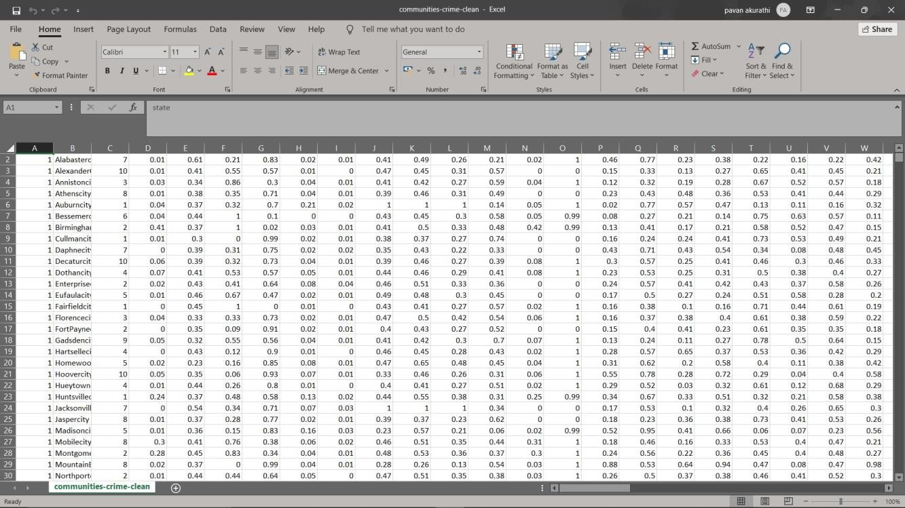
INPUT AND OUTPUT
Eg, DATASET IMAGE
It’s a sample only and may vary according to the project

Slide 29
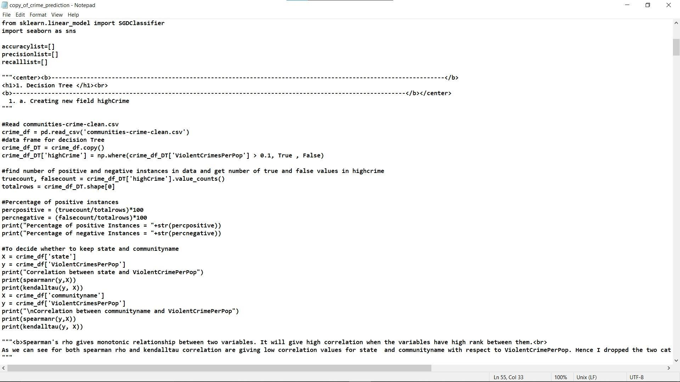
SOURCE CODE
Eg,
It’s a sample only and may vary according to the project

Slide 30
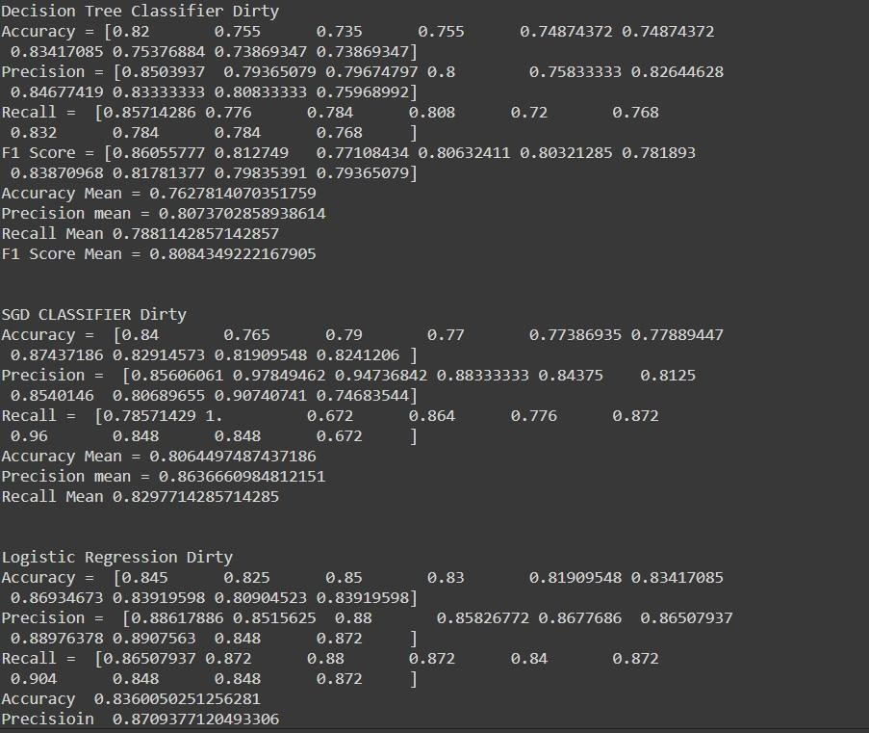
OUTPUT
Eg,
It’s a sample only and may vary according to the project

Slide 31
CONCLUSION
.
System Testing ensures the entire Smart Navigation System functions cohesively, meeting real-world user needs and performance standards.
Integration Testing validates how different components (e.g., sensors, route planning, feedback mechanisms) work together in the system
.
Functional Testing verifies that each individual feature (e.g., obstacle detection, audio guidance, voice commands) operates as intended
.
Testing confirms the system’s reliability, accessibility, and accuracy, providing a seamless and safe navigation experience for blind users.
All testing phases together ensure the system meets specifications, handles edge cases, and delivers on its user-centered goals.

Slide 32
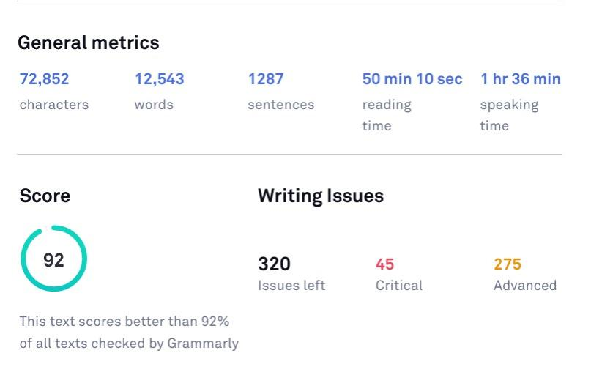
Plagiarism Report of PPT

Slide 33
Web references/video links
A minimum of four sample URLs have to be attached here.

Slide 34
REFERENCES
[1] WafaM.Elmannai. “A Highly Accurate and Reliable Data Fusion Framework for Guiding the Visually Impaired”. IEEE Access 6 (2018) :33029-33054.
[2] Qi-Chao Mao. “MiniYOLOv3:Real-Time Object Detector for Embedded Applications”.IEEE Access 7 (2019) :133529- 133538.
[3] ZhenchaoOuyang. “Deep CNN-Based Real-Time Traffic Light Detector for SelfDriving Vehicles”.IEEE Access 19 (2019):300-313.
[4] Wei Fang. “TinierYOLO:A Real-Time Object Detection Method for Constrained Environments”.IEEE Access 8 (2019) :1935-1944.
[5] Vidula V.Meshram.“An Astute Assisstive Device for Mobility and object Recognition for Visually Impaired People”.IEEE Access 49 (2019) :449- 460.
[6] Kailaspatil.“Fast Deep Neural Networks With Knowledge Guided Training and Predicted Regions of Interests for Real-Time Video Object Detection”.IEEE Access 6 (2018): 8990-8999.

Slide 35
[7] WenmingCao. “Real-Time Online Multi-Object Tracking in Compressed Domain”.IEEE Access 7 (2019): 76489-76499.
[8] Meimei Gong. “Real-Time Detection and Motion Recognition of Human MovingObjects Based on Deep Learning and Multi-Scale Feature Fusion in Video”.IEEE Access 8 (2020):25811- 25822.
[9] Kiruthika.U. Efficient agent-based negotiation by predicting opponent preferences using AHP. Journal of applied research and technology, 16(1), 22-34.
[10] N. Senthil kumar. “SMART EYE FOR VISUALLY IMPAIRED PEOPLE”, International Research Journal of Engineering and Technology, Volume: 07 Issue:06, June 2020.

Slide 36
THANK YOU

